Slide 1
Indirect Sensing Pre-Maintenance
Based on currents data analysis

Slide 2
Background
Customer Requirements
Comprehensive solution for workshop
Less hardware cost input
Timely alarm with on-site system (e.g. HMI)
Challenge
Hardware Cost Control
Downsizing predictive-model learning effort
Demonstrate validation and optimization to customer
Solution
Take full advantage of field electrical data
Combine data analysis algorithm and SPC (Statistical Process Control)
Provide data review tool to support implementation work

Slide 3
Feasibility Analysis based on Currents Data Pre-Maintenance
Exploratory Data Analysis on Currents Data
Statistical Analysis and Forecast
Forecast using LSTM Deep Learning Model

Slide 4
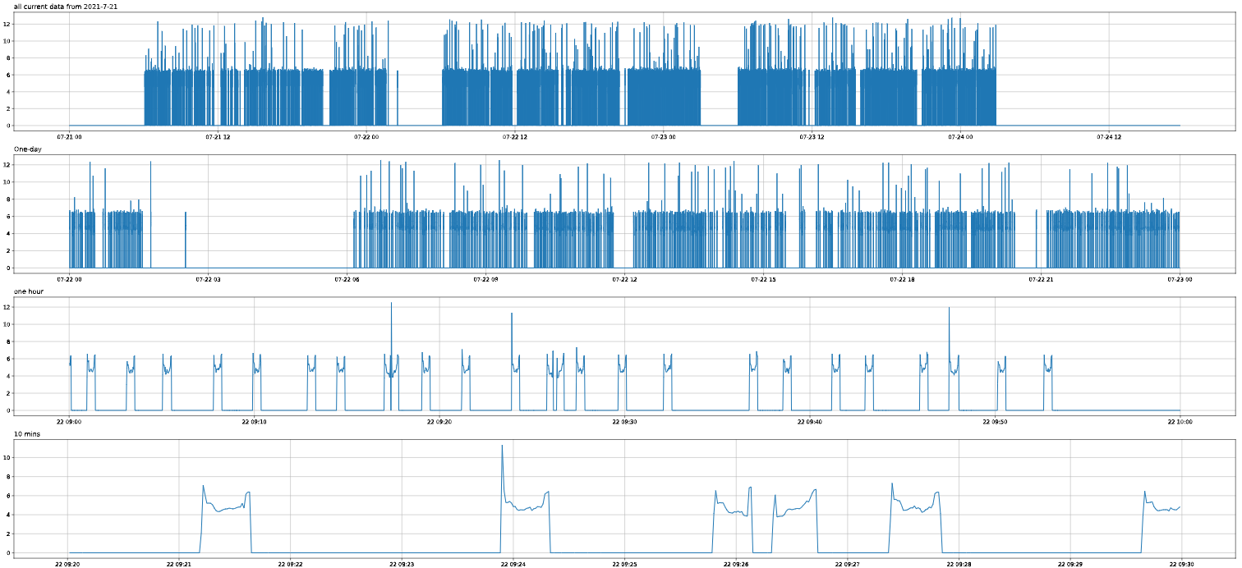
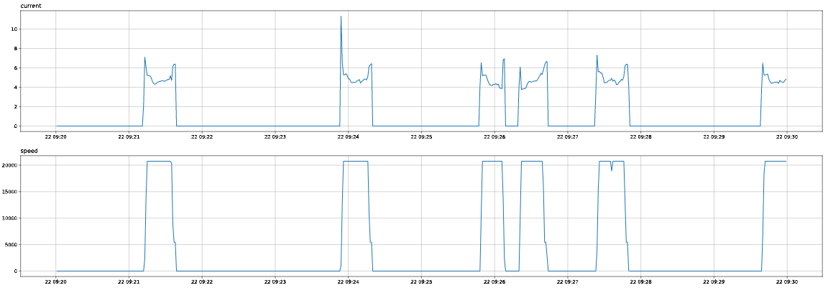
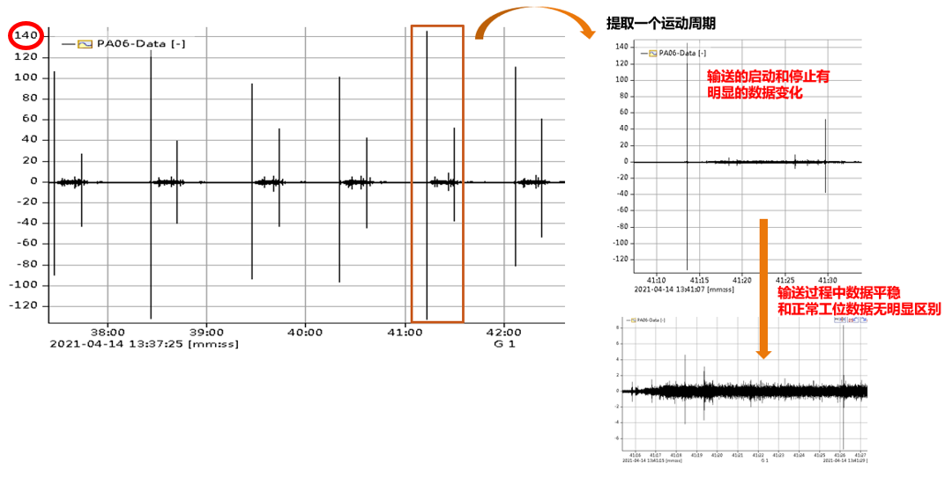
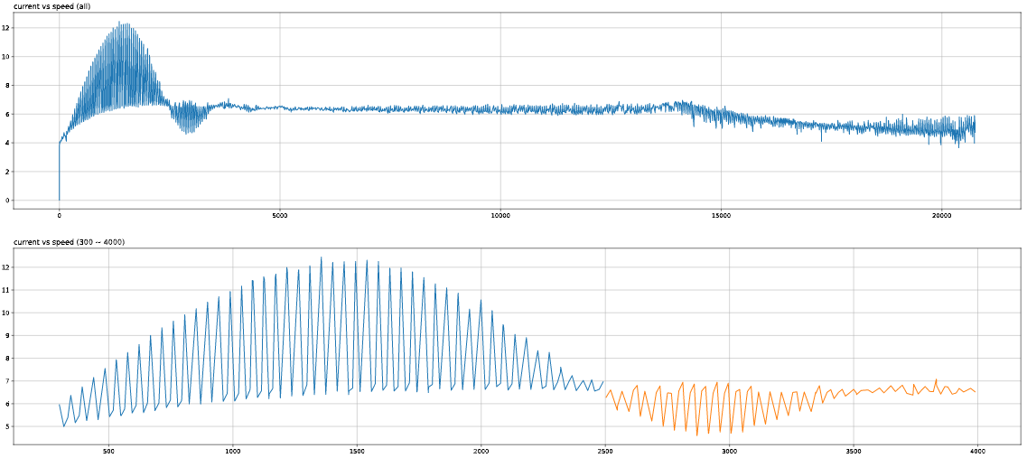
Exploratory Data Analysis on Currents Data
Target: Predictability Judgment
Time Domain Characteristic Analysis
Statistics
Continuity
Periodicity
Correlation
Stationary
→ Distribution characteristics
→ Trend predictability
→ Seasonality predictability
→ Analogy predictability
→ Predictability
Reference Vibration Data
Can reflect
device status based on current data (SR:1s)
SAIC CP2 PA06 Shaft Fault Vibration Data

Slide 5
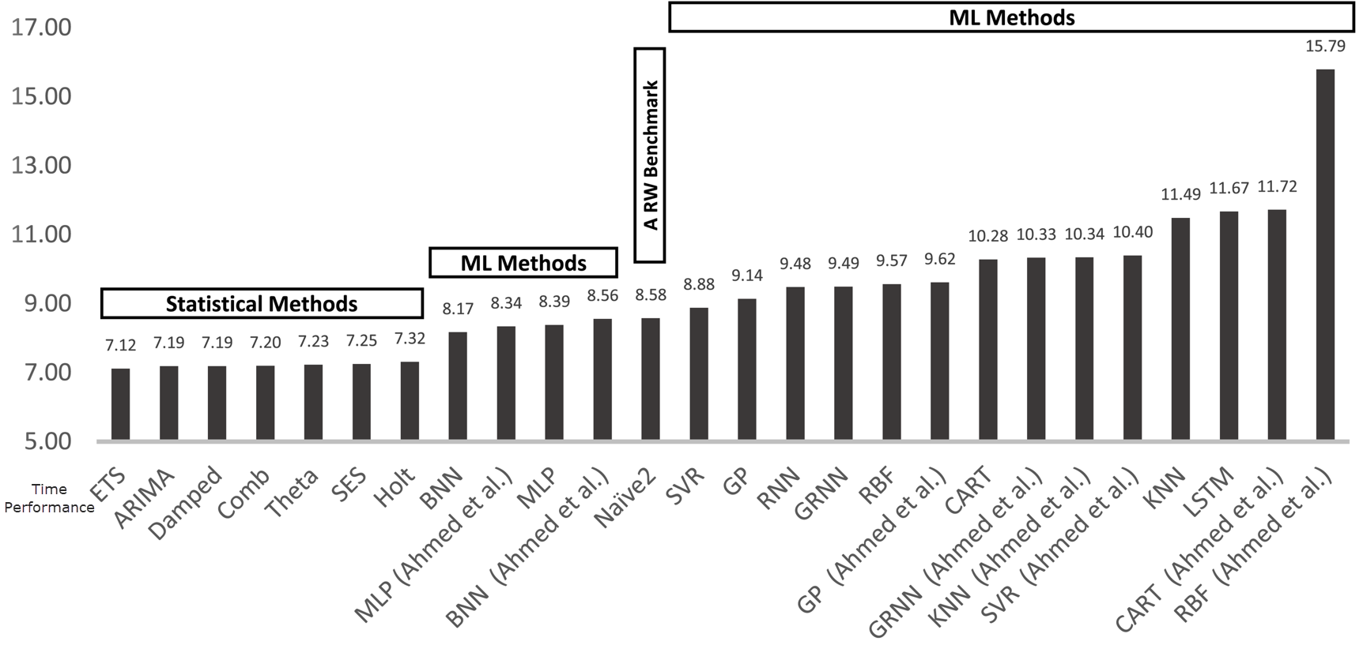
Algorithms Exploration

Slide 6
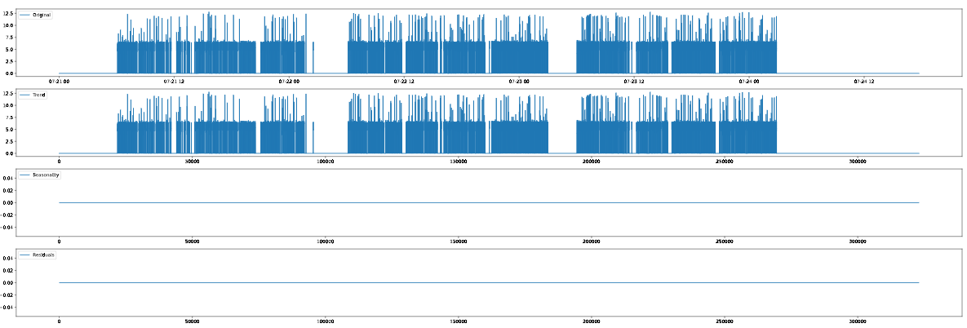
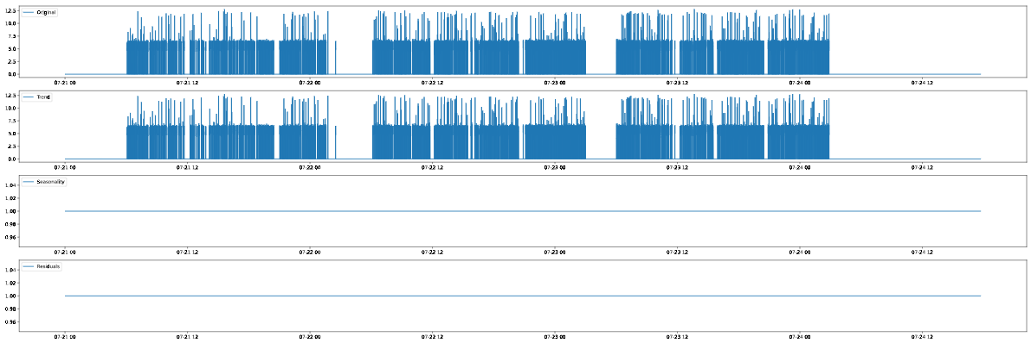
Statistical Analysis and Forecast
Time-Series Decomposition Analysis
Systematic – Components that have consistency or recurrence and can be described and modeled.
Non Systematic – Components that cannot be directly modeled.
Core of Algorithm Model
Additive
y(t) = Level + Trend + Seasonality + Noise
Multiplicative
y(t) = Level * Trend * Seasonality * Noise

Slide 7
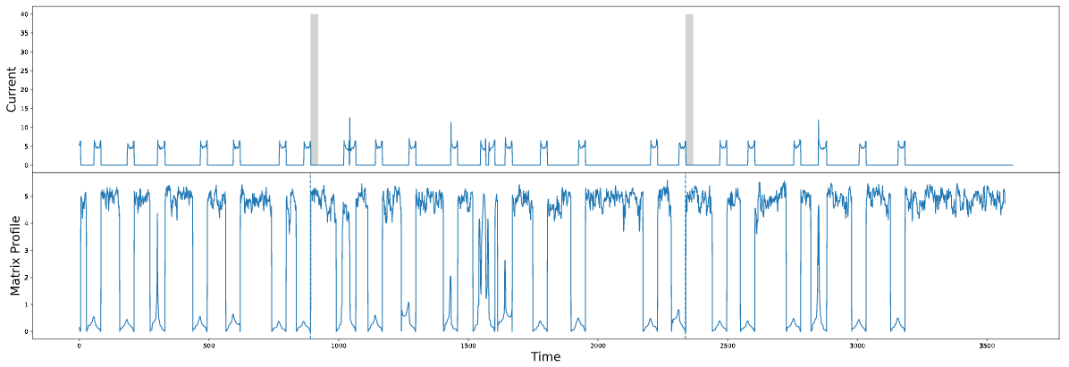
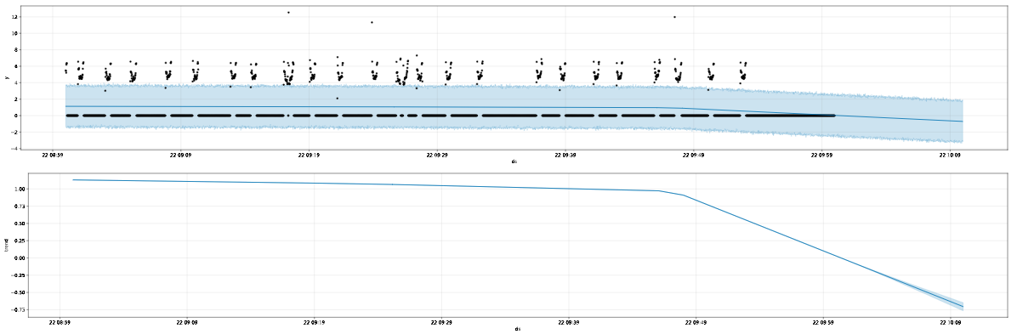
Statistical Analysis and Forecast
Stumpy
Effectiveness：Negative
Prophet

Slide 8
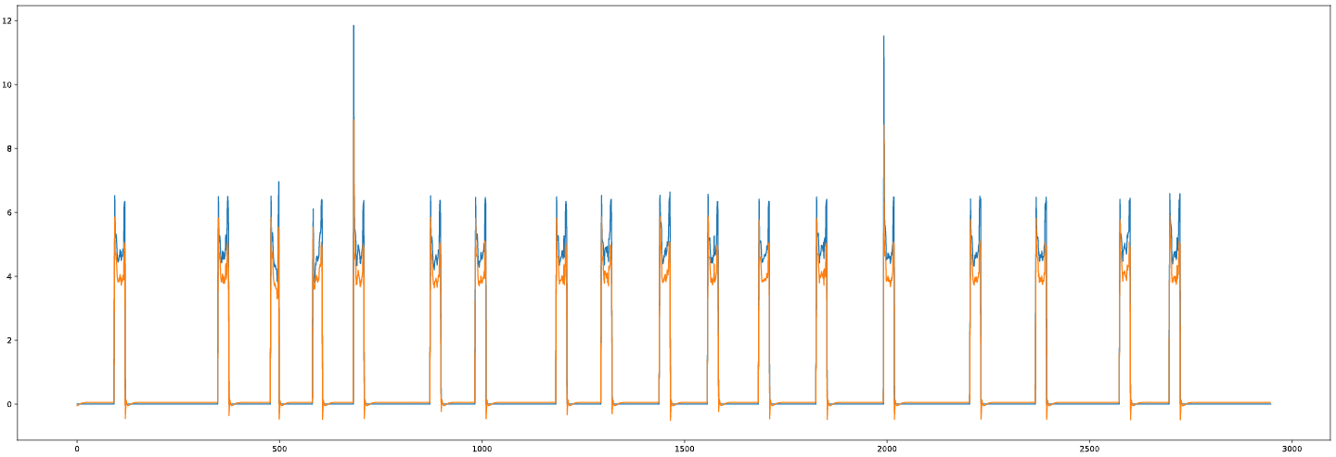
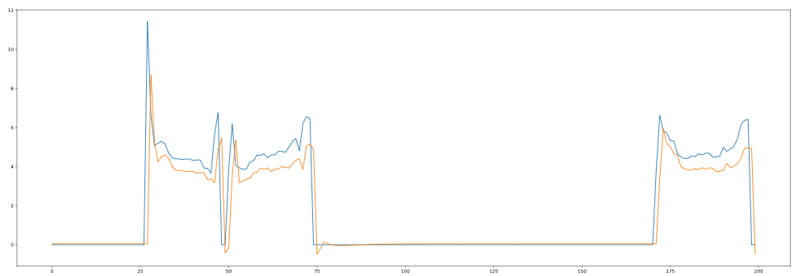
Forecast using LSTM Deep Learning Model
LSTM（Long short time memory), is a deep learning model which can be applied to time series forecasting.
Advantage is capable of automatically learning features from sequence data.
Effectiveness：Negative
The LSTM as a type of RNN in deep learning, can get the features from data automatically to train and predict. But if the data's feature is not so obvious, then LSTM will just scale the shape and make a little delay on the input.
From the plot output, seems good
But predication accuracy, only get 3.66%

Slide 9
Summary
Feasibility
Monitoring device status based on Currents data (SR:1s)
Reliability
Still need understand the work cycle and fault data sample
Scalability
Difficult to realize scalability if it’s just based on algorithms

Slide 10
Proposal based on SPC and Smart Statistics
SPC – Statistical Process Control
Demo

Slide 11
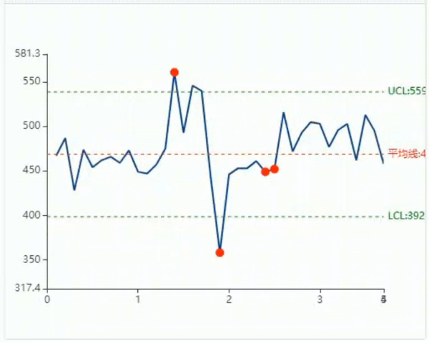
Statistical Process Control
Process control by means of mathematical statistics. It analyzes and evaluates the production process, finds the signs of systematic factors in time according to the real-time information, and takes measures to eliminate random influence ~

Slide 12
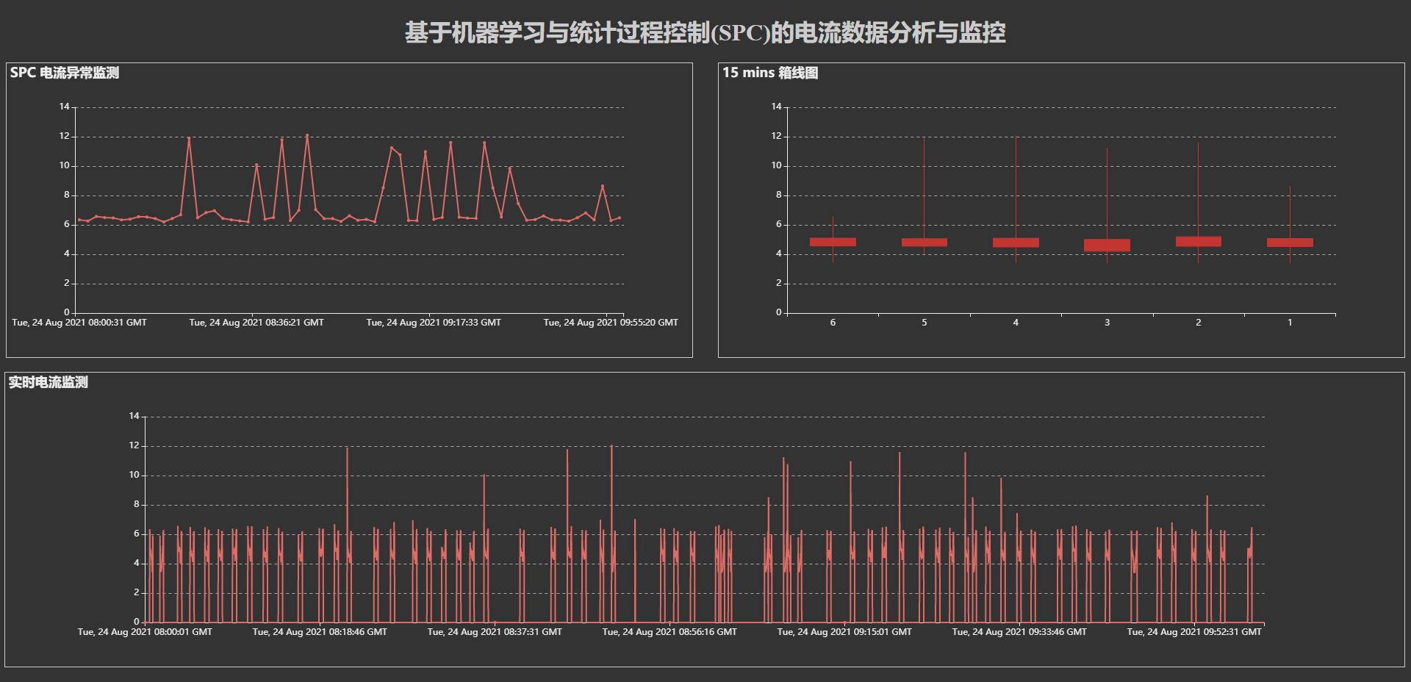
Demo

Slide 13
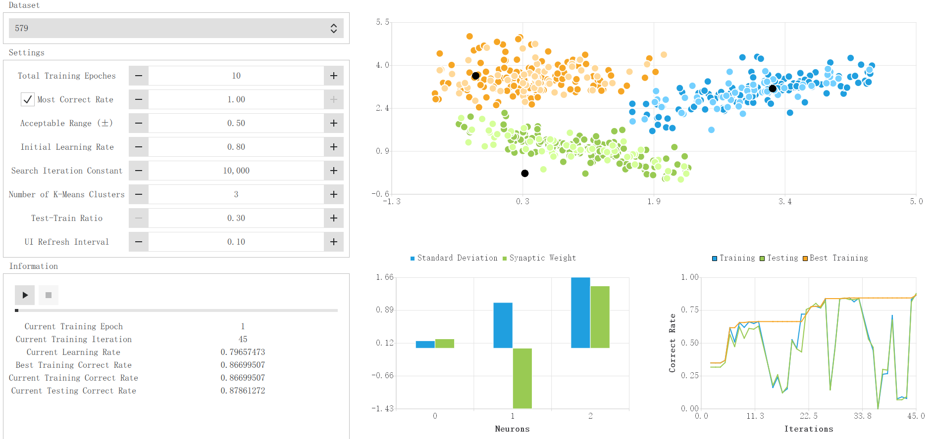
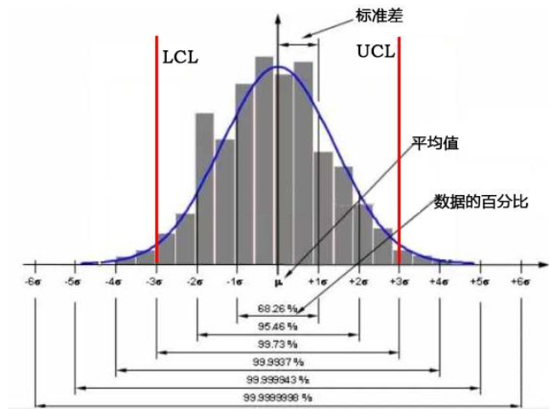

Solution based on SPC and Smart Statistics
Data Collection & Exploration Tool
Statistical Process Control (SPC)
Configurable by Smart Statistics
Implementation Phase
Engineer Tool
Data Visualization
EDA Analysis Results
Delivery Phase
Integrate with SiMaint
Customer Side Web App
Real-time Control and Alert
Optimization Phase
Config parameters in SiMaint by friendly UX
Support self-learning by smart statistics

Slide 14
Questions?
Answers!

Slide 15
Contact
Published by Siemens
T RDA IoT INW-CN
ZHOU Wen Jing
200, Linghu Avenue 214135, Wuxi China
Mobile: +86 18961795415
E-mail: zhou.wenjing@siemens.com

